Slide 1



Core Java
Core Java
Java I/O – Part 1
LEVEL – PRACTITIONER

Slide 2

Objectives
After completing this chapter you will be able to understand,
What is an I/O Stream?
Types of IO Stream.
Byte Stream Vs Character Stream.
Types of Byte Streams.

Slide 3
I/O Streams
An stream represents a sequence of data.
I/O stands for input and output streams.
Streams are used to read data from a source location (or) to write data into a destination location.
Here source can be a keyboard, a file, a disk. Destination can be a file, a disk , console.
Reading From source into stream
Stream
Writing into the destination from the stream
Source
Destination
Streams support different kinds of data streams, simple byte stream, primitive data stream, localized character stream, and objects stream.

Slide 4
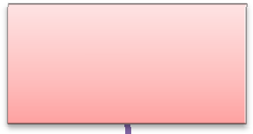
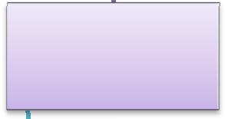
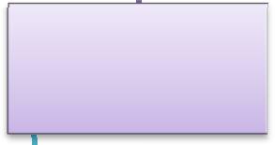


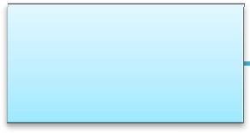
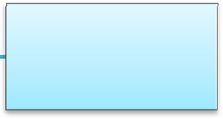
Types of Streams
Used for reading data from external data source into the java application
Stream
Used for writing data from the application program into a external destination.
Input
Output
Used to read /write data in byte format
Byte
Byte
Used to read
/write data in character format
Character
Character
The Input/Output Streams implementation are available in the java.io
package.

Slide 5
Byte Stream
All byte stream classes are descended from two abstract classes
InputStream
OutputStream
Both of these abstract classes have several concrete implementations. For reading and writing data from various sources such as disk files, network connections and memory buffers.
InputStream classes are used for reading data in form of 8 bit bytes from a source ie.one byte at a time.
OutputStream classes are used for writing data in form of 8 bit bytes to a destination ie.one byte at a time.

Slide 6
Input Stream Class
An input stream is used by a Java Program to read byte(s) data from a source.
InputStream, is an abstract class of java.io package
InputStream is the super class of all classes representing an input stream of bytes.
Examples: FileInputStream , DataInputStream.
Input stream will read bytes in a sequential order.

Slide 7
Methods Of InputStream
Method | Description
int read() | Reads the next byte of data from the input stream. The value byte is returned as an int in the range 0 to 255. If no byte is available because the end of the stream has been reached, the value -1 is returned.
int read(byte[] b) | Reads “b.length” number of bytes from the input stream and stores them into the byte array b. Similar to read(b, 0, b.length)
int read (byte[] b, int off, int len) | Reads up to ‘n’ bytes of data from the input stream into the array of bytes ‘b’. ‘off’ - the start offset in array b at which the data is written.
void close() | Closes this input stream and releases any system resources associated with the stream.

Slide 8
Methods Of Input Stream(Cont)
Method | Description
long skip(long n) | Skips over and discards n bytes of data from this input stream.
void mark (int readlimit) | Marks the current position in this input stream. The readlimit arguments denotes the number of bytes to be read before the mark position gets invalidated(reset is called).
int available() | Returns the available number of bytes that can be read (or skipped over) from this input stream.
void reset() | Repositions this stream to the mark position (the position marked by the mark() method).

Slide 9
File Input Stream
FileInputStream class is used for reading the contents of a file as a stream of bytes.
A FileInputStream holds the file contents in the form of bytes.
Path and name of the file to be read
Example:
FileInputStream
fileInput = new FileInputStream(“D:/data.txt”);
Note: An exception named FileNotFoundException is thrown if the file is not present in the specified location.

Slide 10
How to read a file using File Input Stream?
Steps to read data from a file using FileInputStream:
Step 1: Create FileInputStream object by passing the file name with the path as parameter.
FileInputStream fileStream = new FileInputStream("C:/data.txt");
Step 2: Create StringBuffer object to hold the content read from the file, StringBuffer content = new StringBuffer();
Step 3: Iterate the file and read each character using the read method and append the content into the StringBuffer object
while ((ch = fileStream.read()) != -1) { content.append((char) ch);
}
Step 4: Print the content System.out.println(content);
Step 5: Close the stream fileStream.close();

Slide 11
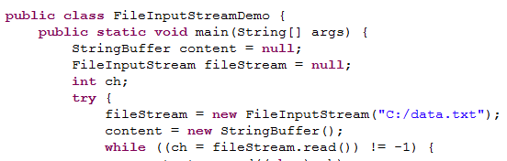
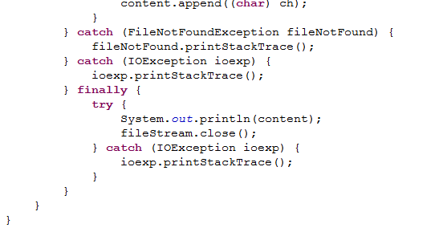

FileInputStream Example
Creates a FileInputStream object on the specified file
Reads one byte at a time using the read() method.
IMPORTANT NOTE:
Always close the streams in finally block.
Never use print stack trace in exception block instead use logging which you will learn in advance java session.

Slide 12
Buffered Input Stream
As the name indicates this uses buffer to read data.
Creates, an internal byte array called buffer, as bytes from the input stream are read.
Since it uses buffer the performance is faster when compared to other streams.
It is used to buffer data of other streams such as FileInputStream, DataInputStream.
Loads data into this buffer from the input stream since it is read from memory when compared to the FileInputStream’s file system approach Buffer Input stream is faster.
Example:
BufferedInputStream buffer=new BufferedInputStream (new
FileInputStream(“c:\data.txt”),1200);
Creates an input buffer of size 1200 to hold the data read from the file “c:\data.txt” using FileInputStream.

Slide 13
Buffered Input Stream (Cont)
The data will be loaded into the buffer based on the size specified when creating the buffer. Since the data is read from the buffer it is faster.
The challenge here is defining the optimal buffer size.
BufferedInputStream contains two important methods mark and reset.
The mark operation create a marker in the input stream.
The reset operation repositions this stream to the position at the time the mark method was last called on this input stream.

Slide 14
BufferedInputStream Example
Steps to read data from a file using BufferedInputStream:
Step 1: Create FileInputStream object for the file to be read
FileInputStream fin = new FileInputStream(“C:/TestData.txt") ;
Step 2: Create BufferedInputStream object by passing the FileInputStream
BufferedInputStream bis = new BufferedInputStream(fin);
Step 3: Use a while loop, read from the BufferedInputStream object using the read()
method
while (bis.available() > 0)
{
System.out.print((char) bis.read());
}

Slide 15
Lend a Hand – BufferedInputStream
Objective: Let us use buffered stream and read a file.
Prerequisite: Create a file named Data.txt and type some data into it.
Create a class named FileBufferTest .java with a main method which will read the content of a file using BufferedInputStream and print the contents in the console.
Logic:
Create the object of FileInputStream class with file name along with the path as argument .
Create the object of BufferedInputStream and pass the reference of FileInputStream to it.
Create an byte array and store the values from the buffer.
Convert the byte array to string and print it.
Expected Output:
“The Content of the file read using BufferedInputStream is : <contents>”

Slide 16
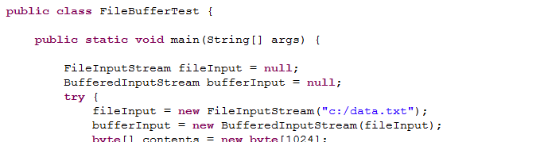
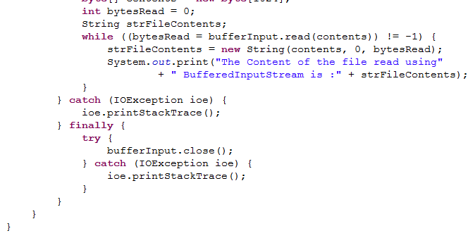
Lend a Hand –Solution
Solution:
Creates a FileInputStream object on the specified file
Creates a Buffer Input Stream from the File Input stream.
Creates a buffer of 1024 bytes
Iterates through the file stream and displays it in the console.

Slide 17
Output Stream class
An output stream is used to write data into a external destination location like a file, network socket, byte array etc..
OutputStream, is an abstract class in java.io package
OutputStream represents an output stream of bytes.
Example: FileOutputStream, ByteArrayOutputStream.

Slide 18
Output Stream Methods
Method | Description
void write(int b) | Writes the specified byte to this output stream.
void write(byte[ ] b) | Writes b.length bytes from the specified byte array to this output stream.
void write(byte[] b, int off, int len) | Writes len bytes from the specified byte array starting at offset off to this output stream.
void flush() | Flushes this output stream and forces any buffered output bytes to be written out.
void close() | Closes this output stream and releases any system resources associated with the stream.

Slide 19
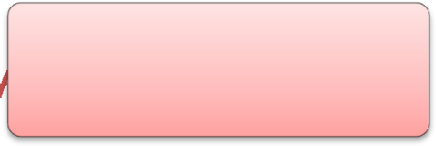
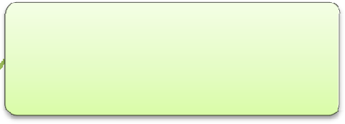

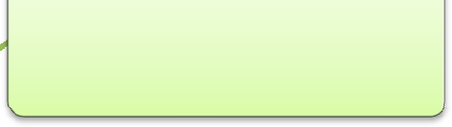
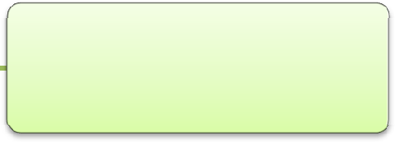
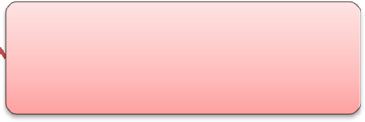
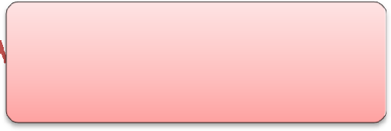
OutputStream Hierarchy
Listed below are the different OutputStream objects, In this session we will focus on
BufferedOutputStream and FileOutputStream.
ByteArrayOutputStream
BufferedOutputStream
FileOutputStream
FileOutputStream
DataOutputStream
FilterOutputStream
OutputStream
FilterOutputStream
PrintStream
ObjectOutputStream
NOTE: Associates are requested to go through the java Documentation to understand about the other stream objects.
PipedOutputStream

Slide 20
FileOutputStream
FileOutputStream is used for writing the contents to a file as a stream of bytes.
Example:
FileOutputStream fileOutput=new FileOutputStream(“D:/file.txt”); Note:
Here the File can be can be .txt, .doc or image files.

Slide 21
File OutputStream Example
Steps to write data into a file using FileOutputStream
Step 1: Create FileOutputSteam object FileOutputStream outStream = null;
Step 2: Create byte Array
byte[] data = new byte[1000];
Step 3: Create String to be written into the file
String str = "This Information is being written to the File";
Step 4: Create output file into which the data is to be written outStream = new FileOutputStream("c:/file.txt");
Step 5: Convert String into byte Array data = str.getBytes();
Step 6: Write the byte array into the file outStream.write(data);

Slide 22
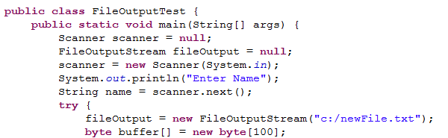
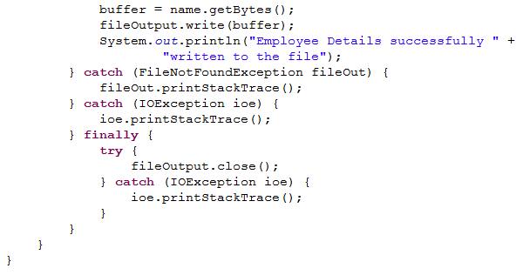
FileOutputStream - Example
Creating a new file and opening the file for writing
Converting the String to byte array and writing the String into the file
Note:
Here the File gets overwritten every time. To avoid this we can use the following constructor to append the files.
FileOutputStream outputStream=new
FileOutputStream("D:\data.txt",true);

Slide 23
BufferedOutputStream
The BufferedOutputStream class uses a buffer to old the data to be writtent into a external location.
The BufferedOutputStream stores the data in a buffer and data is actually written into the destination location only when the buffer is fully utilized.
BufferedOutputStream improves the performance by reducing the number of times the system actually writes data in the actual location.
Example:
BufferedOutputStream buffer=new BufferedOutputStream (new
FileOutputStream(“c:\data.txt”),1024);
The above example creates a buffered output stream with a buffer size of 1Kb to write data to the specified file.

Slide 24
BufferedOutputStream Example
Steps to write data into a file using BufferedOutputStream Step 1: Create FileOutputSteam object
FileOutputStream outStream = new FileOutputStream("C:/newFile.txt");
Step 2: Create BufferedOutputStream object from the FileOutputStream object BufferedOutputStream bufferedOutput = new BufferedOutputStream(outstream);
Step 3: Write into the file using .write method bufferedOutput.write("Line one".getBytes());
bufferedOutput.write("\r\n".getBytes()); bufferedOutput.write(65);

Slide 25
Lend a Hand – BufferedOutputStream
Objective: Let us use buffered stream and write a file.
Create a class named FileBufferOutputTest with a main method which will take the data from console and write to a file using buffered stream.The name of the file should be newFile.txt.
Main method logic:
Create the object of FileOutputStream class and pass the path of the file as argument.
Create the object of BufferedOutputStream and pass the reference of FileOutputStream
to it.
Create an object of scanner class and get the employee id and name from the console.
Append the inputs in the below format
“Welcome <name>, your Employee Id is <empId>
Write the message to a file.

Slide 26
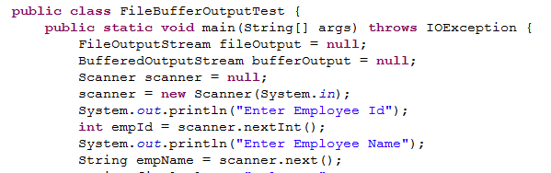
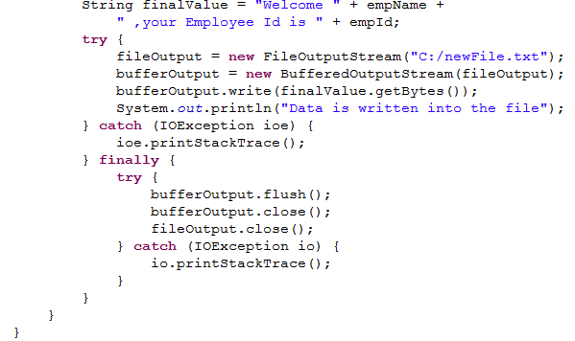
Lend a Hand – Solution
Solution

Slide 27


Core Java
You have successfully completed – Java I/O – Part 1
You have successfully completed –

